Slide 1
Search Engine Optimization (SEO) and Landing Page Optimization: Industry Practice and Recommendations for CardioDx® and CardioDx.com
Elena Sevastopoulos
August 2, 2012
Notes:
ADD AGENDA SLIDE

Slide 2
Project Overview
Objective:
To understand the users of CardioDx.com and evaluate their interaction on the website via Google Analytics
To evaluate CardioDx.com’s SEO practices relative to industry trends and standards
To recommend an SEO and landing page strategy and implementation plan
Methodology:
Utilized and analyzed Google Analytics, Webmaster Tools, SEOmoz, webpage source code
Goal
To drive more users to the website and increase visitor retention
Notes:
Assess using google analytics who is visiting the website and how they interacting with the website.
To evaluate CardioDx.com’s SEO practice relative to industry trends and standards.
To recommend an SEO and landing page strategy and implementation plan

Slide 3
Agenda
Understanding User Traffic & Behavior
Traffic, Pageviews, Keyword Searches and Mobile Device Access
Search Engine Optimization
On-Page Factors
Title Tags, Meta Tags and Headers
Keyword/Keyphrase Integration
Content Additions
Landing Page Optimization
Testing of Landing Page Components
A/B Testing
Additional Recommendations
Inbound Links to CardioDx.com from Other Credible Sites
Social Media Benchmarking

Slide 4
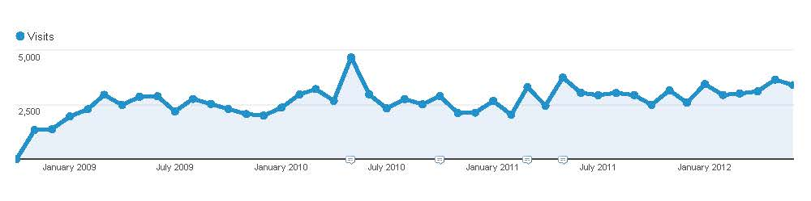
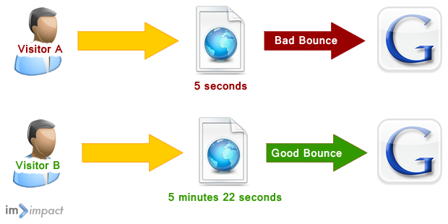
Visitor Overview Since October 2009
Google Analytics data from October 2009 – June 2012
Visits: 119,519
Unique Visitors: 73,223
Pageviews: 432,897
Pages / Visit: 3.62
Avg. Visit Duration: 00:03:06
Bounce Rate: 33.01%*
% New Visits: 61.04%
GE collaboration
May 13, 2010
Bounce Rate Explanation
Visits is the number of visits to your site.
Unique Visitors is the number of unduplicated (counted only once) visitors to your website
Pageviews is the total number of pages viewed. Repeated views of a single page are counted.
Pages/Visit is the average number of pages viewed during a visit to your site.
Avg. Visit Duration is the average time duration of a session.
Bounce Rate is the percentage of single-page visits (i.e. visits in which the person left your site from the entrance page).
% New Visits is the percentage of visits that were first-time visits (from people who had never visited your site before).
*Industry average bounce rate: 40%
Notes:
Show google traffic over the months
Add arrow for spike
Visits have been constant
Footnote with why so many returning visitors

Slide 5
Monthly Visitor Overview
Google Analytics data from April 28 - May 28, 2012
Visits: 3,475
Unique Visitors: 2,453
Pageviews: 10,161
Pages / Visit: 2.92
Avg. Visit Duration: 00:02:40
Bounce Rate: 39.97%
% New Visits: 60.49%
Daily Visits (April 28 - May 28, 2012)
Visits is the number of visits to your site.
Unique Visitors is the number of unduplicated (counted only once) visitors to your website, identified using cookies, over an identified time period (one month here).
Pageviews is the total number of pages viewed. Repeated views of a single page are counted.
Pages/Visit is the average number of pages viewed during a visit to your site.
Avg. Visit Duration is the average time duration of a session.
Bounce Rate is the percentage of single-page visits (i.e. visits in which the person left your site from the entrance page).
% New Visits is the percentage of visits that were first-time visits (from people who had never visited your site before).
Notes:
What does new visitors returning visitors v unique visitors, visits
Talk about IP address

Slide 6
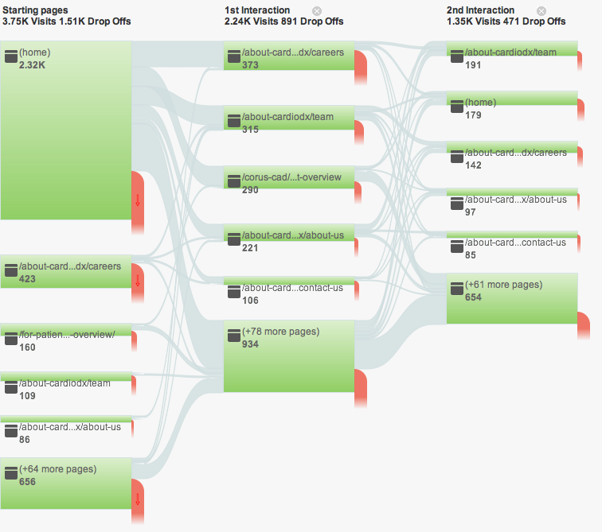
Cardiodx.Com Visitor Flow Diagram
Google Analytics data from April 28 - May 28 2012
Most visitors land or start on the homepage.
The second most popular landing page is Careers
The top 3 pages visited after landing on the homepage are Careers, Team, and Corus CAD Overview
64%
17%
14%
13%
14%
11%
13%
7%
10%
6%
12%
5%
5%
4%
42%
3%
Height of bar correlates with number of pageviews.
Red spout signifies visitor drop-offs or exits
2%
17%
Notes:
Size of bar equals number of pageviews, relabel, look at doing handout
Make Percentages
Key Takeways

Slide 7
Top Ten Pageviews
The home, career and team pages are viewed most often
The homepage has a low bounce rate because visitors find it relevant and often click through to other pages before exiting the site
Google Analytics data from April 28 - May 28 2012.
Unique Pageviews is the number of visits during which the specified page or pages are viewed at least once. Avg.
Avg. Time on Page is the average amount of time visitors spent viewing a specified page or set of pages.
Bounce Rate is the percentage of single-page visits (i.e. visits in which the person left your site from the entrance page).
/ = http://cardiodx.com/
Notes:
Yellow top 3, number them, add percentages! Label homepage.

Slide 8
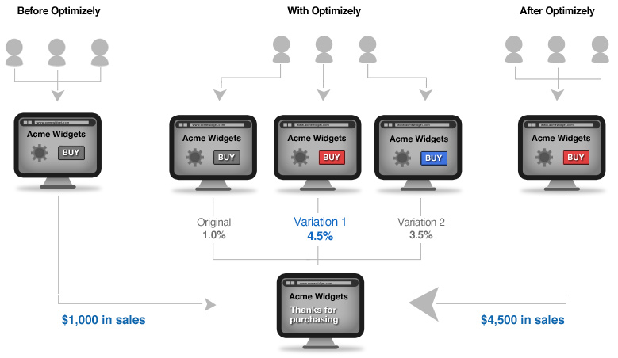


3 Sources of Traffic to CardioDx.com
Direct/Organic
typing “CardioDx.com”
21.8%
Search Engine
59.5%
Referral
from other websites via inbound links
18.7%

Slide 9
59.5% Of Total Visitors Come From Search Engines
Google Analytics data from April 28- May 28, 2012
Visitors primarily search or google the keyword “cardiodx”
Bounce rate is low for most search keywords, except Board of Directors and the Compass Trial
Visitors are searching for your Board of Directors and not finding them so they bounce.
Visitors might bounce from The Compass Trial page because the content is possibly too technical or they might be searching for GlaxoSmithKline’s COMPAS trial.
Visitors are also searching for team members directly and for specific studies (but these account for very few visits)
Keyword | % of Visits | Visits | Primary Landing Page(s) | Pages/Visit | Avg. Visit Duration | Bounce Rate
cardiodx | 22.70% | 790 | / (homepage) | 3.46 | 0:03:20 | 30.76%
 |  |  | /about-cardiodx/careers
cardio dx | 3.40% | 118 | / (homepage) | 2.9 | 0:01:35 | 33.05%
 |  |  | /about-cardiodx/careers
corus cad | 0.80% | 27 | /for-patients/corus-cad-overview/ | 2.56 | 0:01:31 | 33.33%
 |  |  | / (homepage)
cardiodx inc | 0.70% | 25 | / (homepage) | 3.2 | 0:04:58 | 16.00%
cardiodx careers | 0.70% | 24 | /about-cardiodx/careers | 2.83 | 0:02:26 | 50.00%
cardiodx, inc. | 0.70% | 24 | / (homepage) | 3.46 | 0:01:53 | 37.50%
caridodx | 0.40% | 14 | / (homepage) | 1.21 | 0:00:03 | 85.71%
cardiox | 0.40% | 13 | / (homepage) | 1.92 | 0:00:20 | 53.85%
cardiodx board of directors | 0.30% | 11 | /about-cardiodx/team | 2.91 | 0:05:19 | 54.55%
compass trial | 0.30% | 11 | /research-and-development/coronary-artery-disease/compass-trial/ | 1.55 | 0:01:24 | 63.64%
david levison cardiodx | 0.10% | 2 | /about-cardiodx/team | 5 | 0:06:23 | 0.00%
mark monane cariodx | 0.10% | 2 | /about-cardiodx/team | 6 | 0:01:10 | 0.00%
blood-based genomic test better than imaging test for ruling out obstructive coronary artery disease | 0.02% | 1 | /about-cardiodx/newsroom/press-releases/cardiodx-blood-based-gene-expression-test-demonstrates-superior-performance-to-myocardial-perfusion-imaging-to-rule-out-obstructive-coronary-artery-disease | 3 | 0:00:46 | 0.00%
Visits is the number of visits to your site.
Landing Page is the first page that a user views during a session. This is also known as the 'entrance page.’
Pages/Visit is the average number of pages viewed during a visit to your site.
Avg. Visit Duration is the average time duration of a session.
Bounce Rate is the percentage of single-page visits (i.e. visits in which the person left your site from the entrance page).
/ = http://cardiodx.com/
Notes:
Animate boxes

Slide 10
18.7% Of Visitors Come From Referral Traffic/Inbound Links
Google Analytics data from April 28- May 28, 2012
20% of referral traffic comes from edisonawards.com (in May)
20% of referral traffic approximately comes from career/job websites (in May)
Inbound links are links from pages on external sites linking back to your site.
Visits is the number of visits to your site.
Pages/Visit (is the average number of pages viewed during a visit to your site.
Avg. Visit Duration is the average time duration of a session.
% New Visits is the percentage of visits that were first-time visits (from people who had never visited your site before).
Bounce Rate is the percentage of single-page visits (i.e. visits in which the person left your site from the entrance page).
Notes:
Add note about careers/job visits

Slide 11
Mobile Devices are Used to Access Cardiodx.Com
8.4% of site visits are via mobile devices
7.5% of site visits are via Apple iOS devices, iPad and iPhone
Google Analytics data from April 28- May 28, 2012
Visits is the number of visits to your site.
Pages/Visit (is the average number of pages viewed during a visit to your site.
Avg. Visit Duration is the average time duration of a session.
% New Visits is the percentage of visits that were first-time visits (from people who had never visited your site before).
Bounce Rate is the percentage of single-page visits (i.e. visits in which the person left your site from the entrance page).

Slide 12
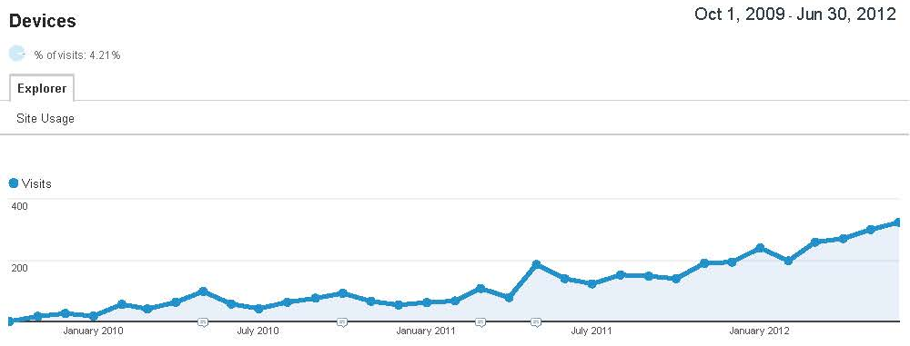
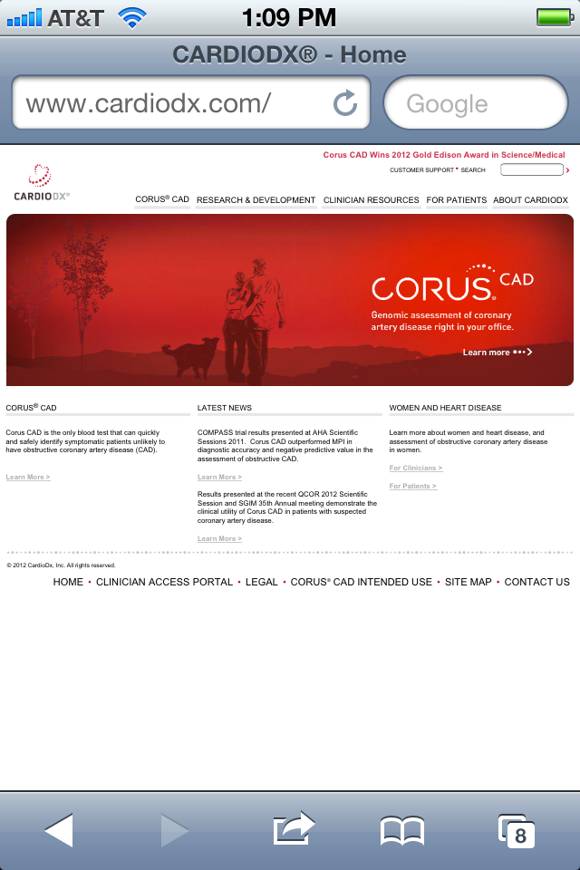
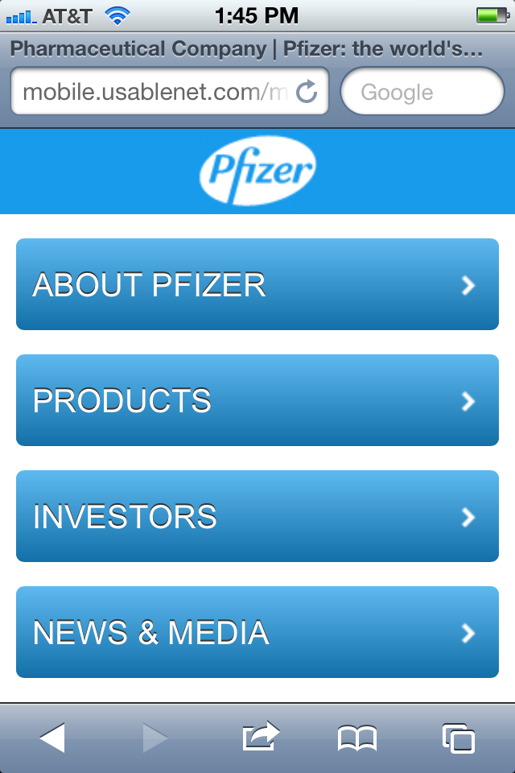
Recommendation: CardioDx Should Create a Mobile Website
Mobile device usage is on the rise. By 2014 mobile internet use will have overtaken desktop access.*
Nearly 10% of visits to CardioDx.com are from mobile devices: This is a two-fold increase in mobile device visits when compared to the same time period last year.
Mobile versions of websites are becoming more prevalent and necessary
CardioDx.com is small and hard to read on a phone screen
Pfizer’s site is optimized for mobile viewing and easy to read and navigate
CardioDx.com mobile device visits
Oct 1, 2009 – June 30, 2012
5%
10%
2-fold
*ComScore State of the Internet Webinar; June 14, 2012
Notes:
Look for Healthcare example of mobile site

Slide 13
Top 3 Homepage Clicks*
#2
8.8%
2.2%
3.1%
0.8%
0.6%
4.3%
#1
12%
0.1%
0.3%
2.9%
0.9%
0.8%
1.1%
0.2%
0.1%
0.5%
3.9%
#3
*Google Analytics data from April 28- May 28, 2012. Click data excludes Flash animation.
Notes:
Try to figure out how to label, with boxes
TOP 3 HOMPEPAGE

Slide 14
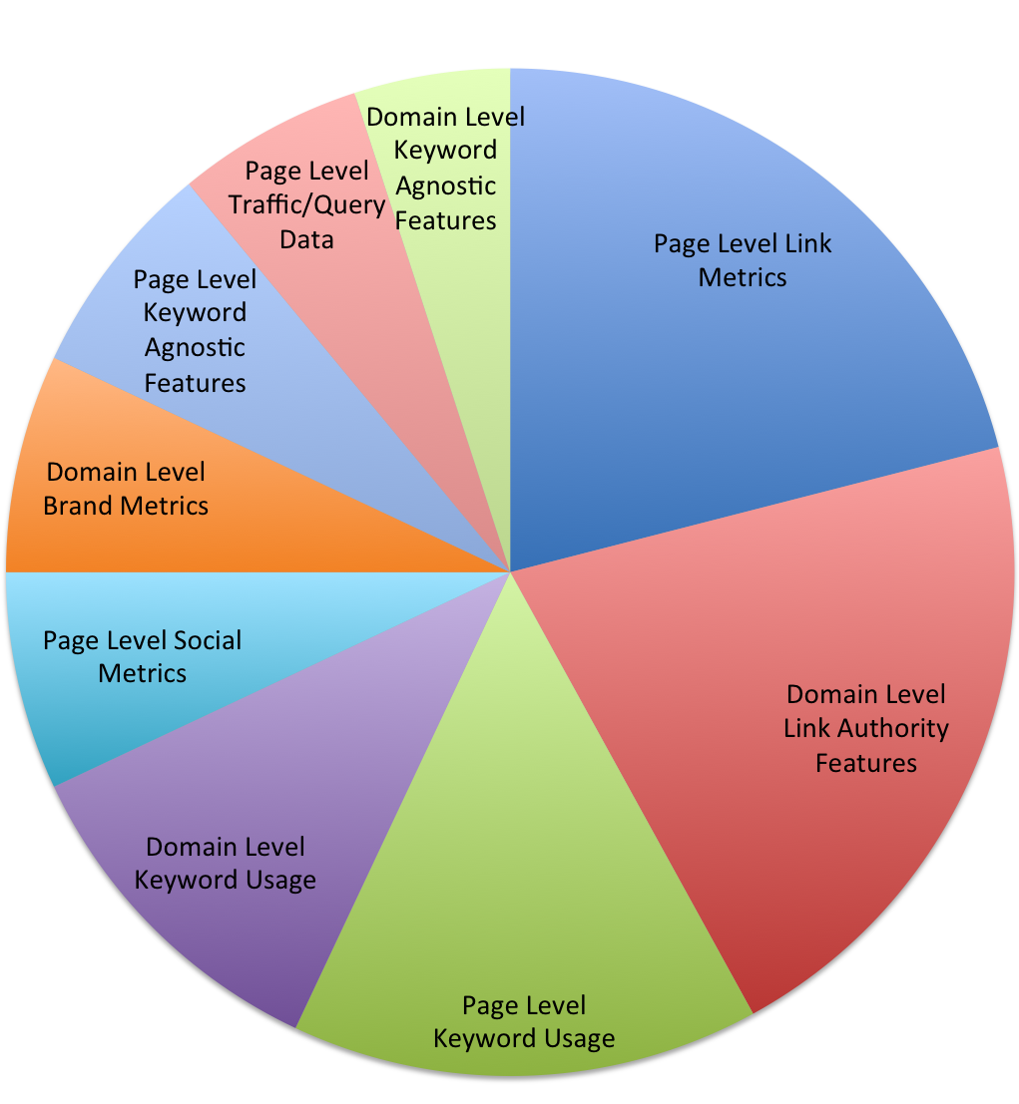
Factors Important For Ranking High In Search Engine Results
Page Level Link Metrics This is the number of incoming links to a page. Search engines look at the quantity of unique incoming links as well as the topical relevance of the linking pages.
Domain Level Link Authority Features This is the number of incoming links to a domain as a whole.
Page Level Keyword Usage This refers to keywords in the HTML of your page. In order for your site to be indexed properly for search, you should be using keywords in the following: H1 Headings tags, HTML Page Titles, Meta Description, URLs, Images file names and ALT tags
Domain Level Keyword Usage As noted above, keywords should be used in your URLs.
Page Level Social Metrics Social media platforms are playing an increasingly important role in SEO. When asked about the future of search, the majority of respondents believe that social metrics will increase in importance.
* SEOmoz 2011 Search Ranking Factors
Notes:
14
Account for 21% of Google position

Slide 15
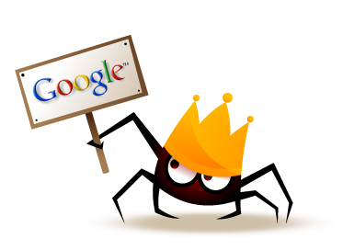
Search Engines Organizes Information For Easier Retrievability
1) Search Engine Crawl
Search engine crawls the web for information
This task is performed by a piece of software, called a crawler or a spider (or Googlebot, as in the case of Google)
2) Page Indexing
After a page is crawled, the next step is to index its content
The indexed page is stored in a giant database, from where it can later be retrieved.
Essentially, the process of indexing is identifying the words and expressions that best describe the page and assigning the page to particular keywords.
3) Page Relevancy
When a search request comes, the search engine processes it – i.e. it compares the search string in the search request with the indexed pages in the database.
The search engine starts calculating the relevancy of each of the pages in its index with the search string and then retrieves search results
* “Introduction – What is SEO” http://www.webconfs.com/seo-tutorial/introduction-to-seo.php
Notes:
FIX LAYOUT

Slide 16
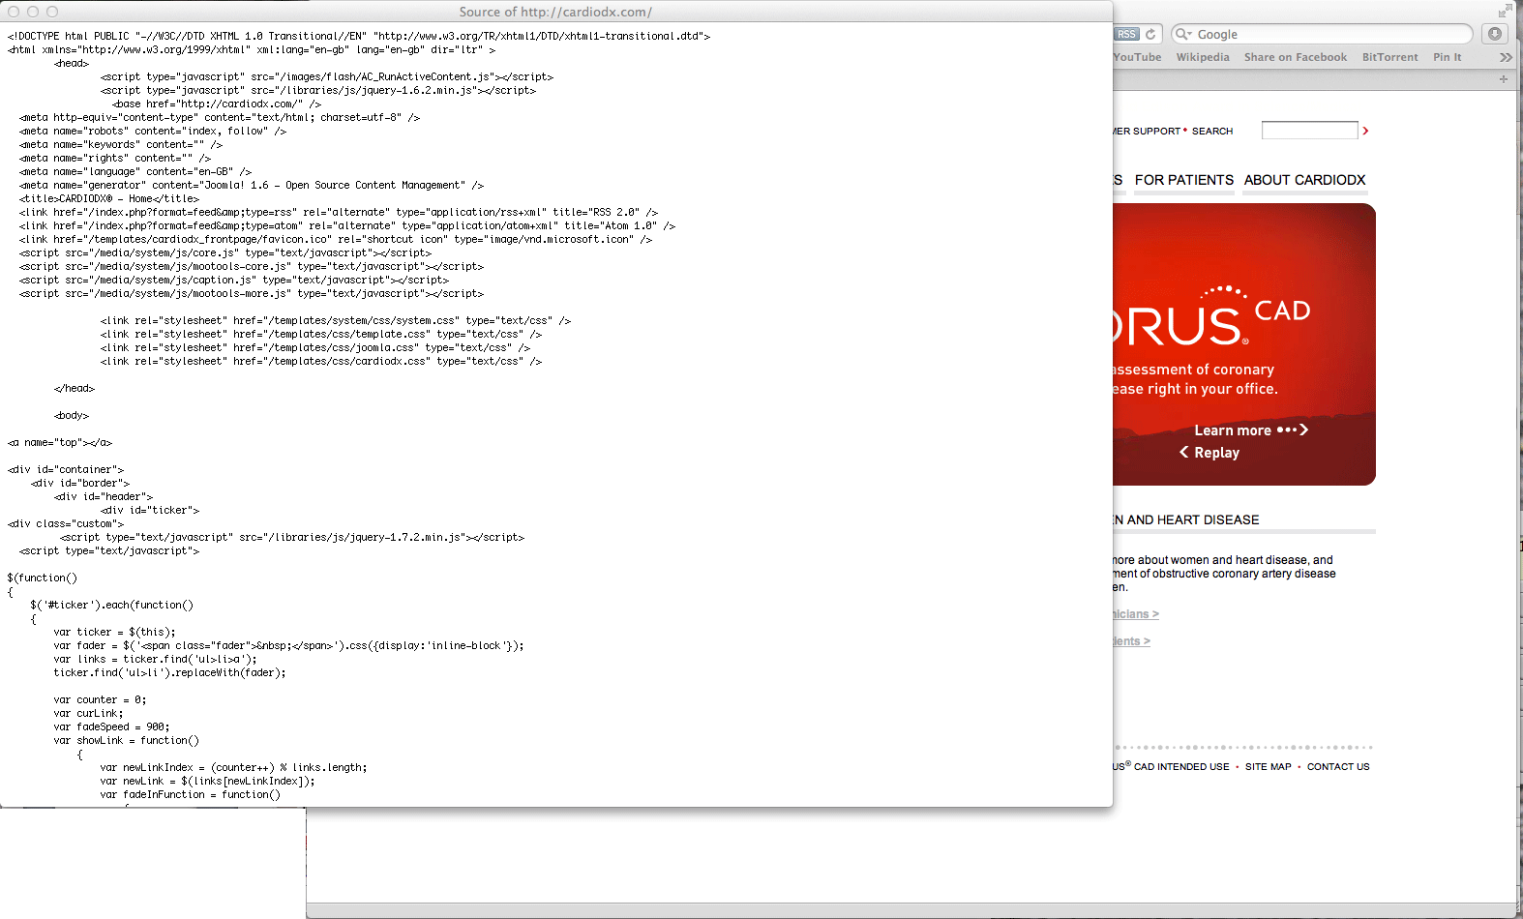
Source Code Is Instrumental In Google Indexing And SEO
The source code is the blueprint for each webpage. There are factors and components in it that Google indexes that can be optimized so that Google will rank the page higher in search results.

Slide 17
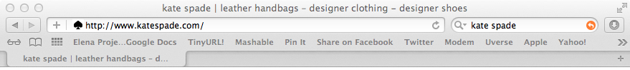
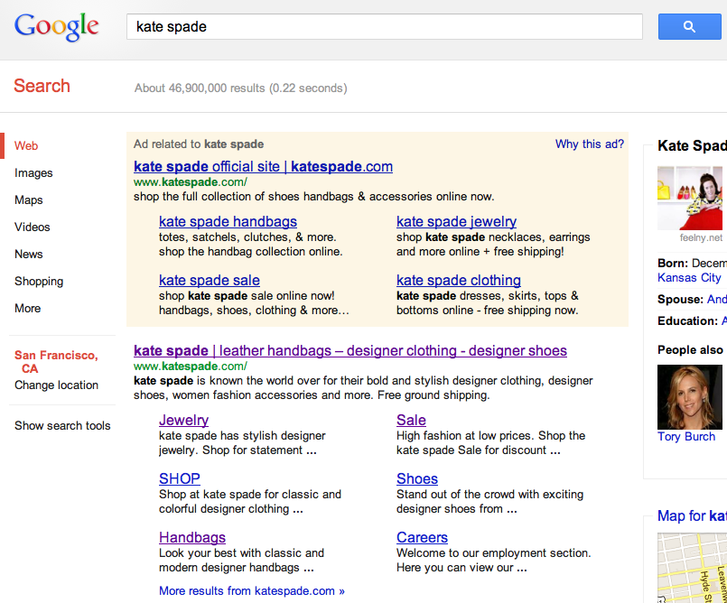
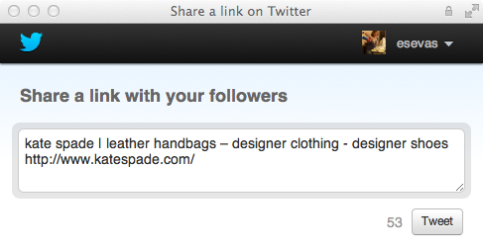
Search Engine Optimization #1: Title Tags
Title Tag
Main text that describes an online document
Single most important on-page SEO element
Google crawls and indexes title tags
Appears in 3 places:
In the top of browsers and in applicable tabs
Search Results Pages
External Websites (e.g. social media)
Best Practice:
Fewer than 70 characters (17 title tags within CardioDx.com are longer than 70 characters)
Example: kate spade | leather handbags – designer clothing - designer shoes
#1
#2
#3
Notes:
Number title tag appearances

Slide 18
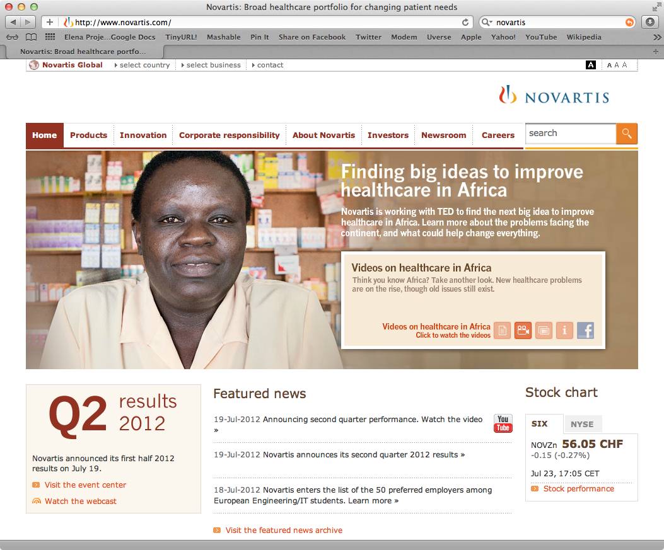
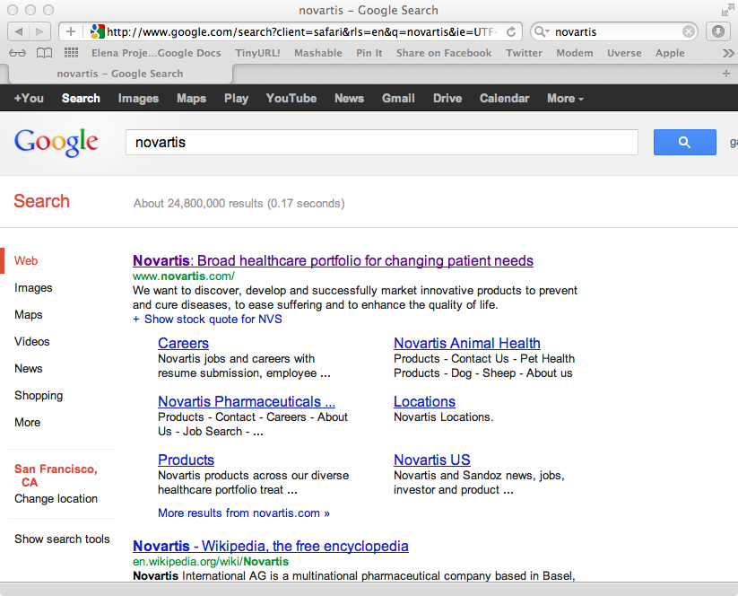
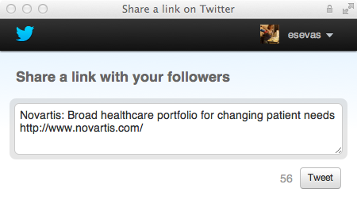
Example of a Good Title Tag: Novartis
An example of a good title tag is one that is descriptive and describes your: company name AND product/service
Novartis: Broad healthcare portfolio for changing patient needs
Notes:
A title tag is the main text that describes an online document. It is the single most important on-page SEO element (behind overall content) and appears in three places:
Add arrows for product/service company
USE NOVARTIS AS EXAMPLE

Slide 19
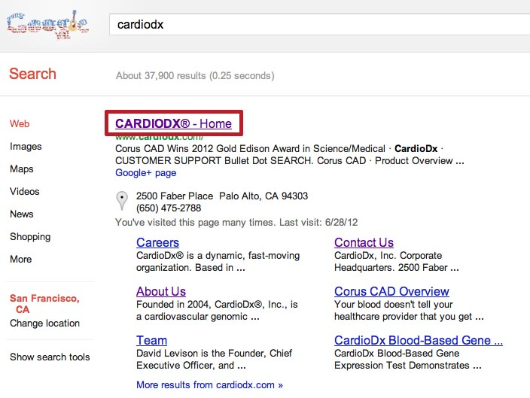
Recommendation #1: Make Cardiodx’s Title Tag More Descriptive and Shorten Site Title Tags
The title for the CardioDx.com homepage is not descriptive. It is currently CARDIODX® - Home and should be changed to the following:
CARDIODX® | Cardiovascular Genomic Diagnostics Company
Also, shorten 17 other title tags within the site that are currently longer than 70 characters
Notes:
A title tag is the main text that describes an online document. It is the single most important on-page SEO element (behind overall content) and appears in three places:

Slide 20
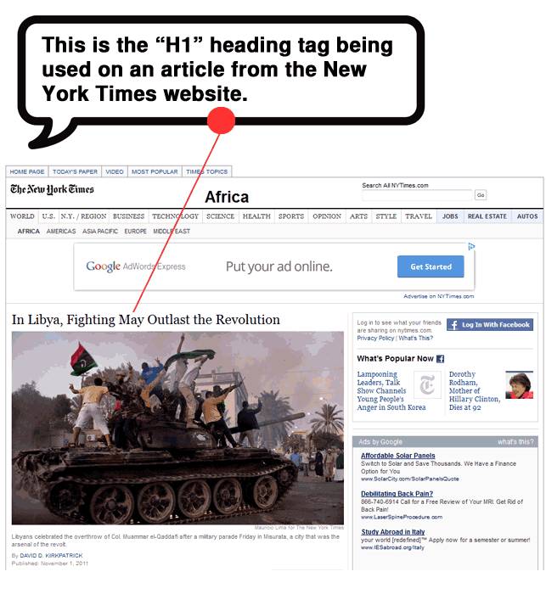
Search Engine Optimization #2: Header Tags
Header Tags
Second most important factor in on-page SEO
The tags are contained in the source code and indicates importance to Google
Google crawls and indexes header tags
Up to six header tags:
H1; H2; H3; H4; H5; H6
Each header tag indicates the relative importance of the section it heads.
H1 indicates the highest level of importance and H6 is the lowest.
Notes:
20
Tie it into google search and google slide

Slide 21
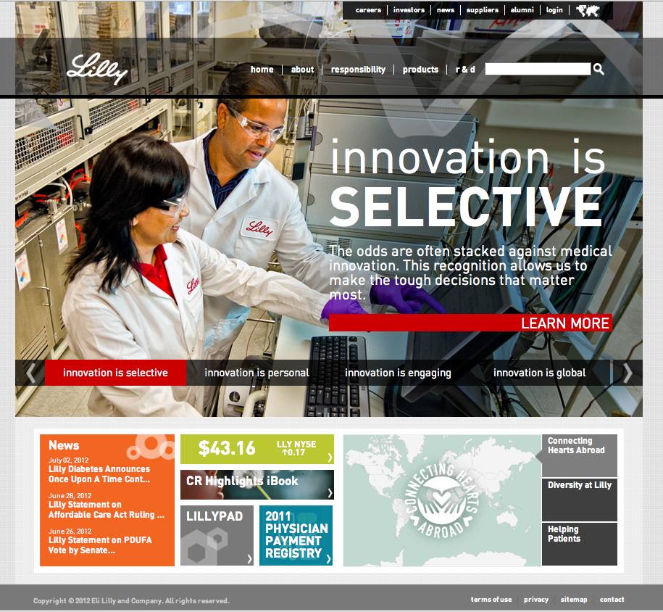
Example Of Effective Header Tags: Eli Lilly
The header tags are
effective because they are labeling highly searched keywords that are relevant to Eli Lilly’s brand
Keyword examples: Responsibility, global, lilly, medical innovation
Best practice is to order header tags from H1 to H6, top to bottom
H1
H3
H4
H2
Notes:
21
Explain why header tags increase SEO. Especially if they don’t appear on search engine results page. Explain how google crawls.

Slide 22
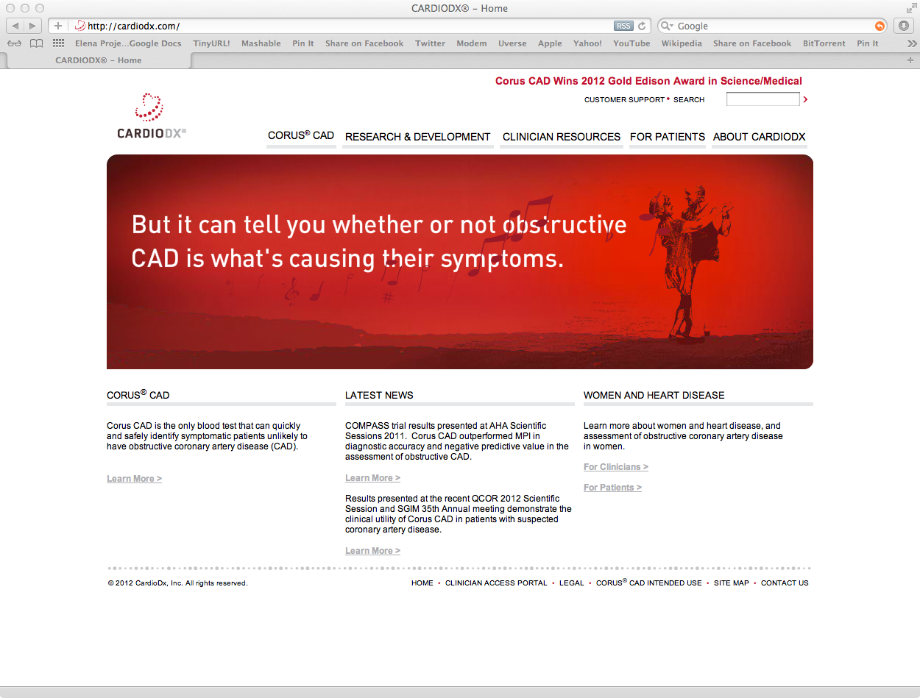
Recommendation #2: Add Header Tags to Cardiodx.com Homepage
CardioDx.com header tag placement should follow the H1 to H6 hierarchy and label important keywords/content
H1
H1 tag the homepage link for the CardioDx logo
H2
H3

Slide 23
Search Engine Optimization #3: Meta Tags
Meta Tags
Short statement describing the content of a page and is an opportunity to advertise content to searchers
Extremely important in gaining user click-through from search engine result pages
Description should employ keywords intelligently, and create a compelling description that a searcher will want to click
Description should be between 150-160 characters*
Recommend a meta description tag for every page of a website
Click through rate is the rate (expressed in a percentage) at which users click on a link to your page from a search engine results page
*”Meta Description Tag - SEO Best Practices | SEOmoz” http://www.seomoz.org/learn-seo/meta-description
Notes:
THERE SHOULD BE A META TAG FOR EVERY PAGE.
Meta description tags, while not important to search engine rankings, are extremely important in gaining user click-through from search engine result pages (SERPs). These short paragraphs are webmasters opportunity to advertise content to searchers and let them know exactly what the given page has with regard to what they’re looking for.
The meta description should employ the keywords intelligently, but also create a compelling description that a searcher will want to click. Direct relevance to the page and uniqueness between each page’s meta description is key. The description should optimally be between 150-160 characters.
USE ECOMMERCE AS AN EXAMPLE

Slide 24
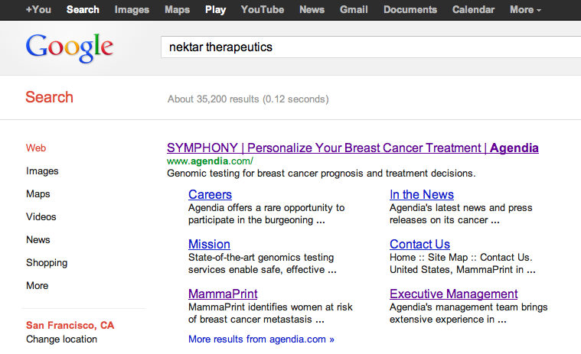
Example of Good Meta Description Tags: Agendia
A good meta description tag will increase the click-through rate and describe the content of a page well
Example of a good meta description tag: “Genomic testing for breast cancer prognosis and treatment decisions.”
There are meta description tags on most pages of this site
Notes:
USE ABBOTT AS AN EXAMPLE. THERE SHOULD BE A META TAG FOR EVERY PAGE.
Meta description tags, while not important to search engine rankings, are extremely important in gaining user click-through from search engine result pages (SERPs). These short paragraphs are webmasters opportunity to advertise content to searchers and let them know exactly what the given page has with regard to what they’re looking for.
The meta description should employ the keywords intelligently, but also create a compelling description that a searcher will want to click. Direct relevance to the page and uniqueness between each page’s meta description is key. The description should optimally be between 150-160 characters.

Slide 25
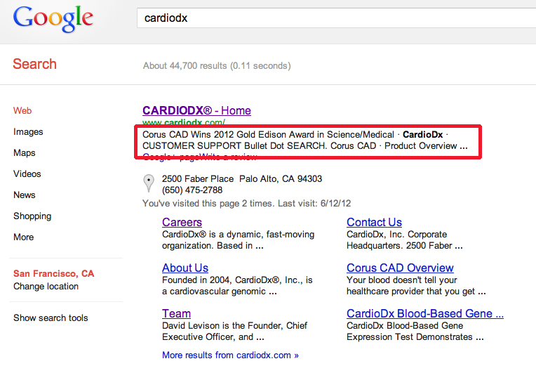
Recommendation #3: Create Meta Tags For All Pages Of CardioDx.com
Meta tags are missing on all 185 pages of CardioDx.com
For example, the homepage meta description tag should be changed to something more descriptive like the following: “CardioDx®, Inc. is a cardiovascular genomic diagnostics company, committed to improving the quality of care for patients with cardiovascular disease.”
Notes:
Meta description tags, while not important to search engine rankings, are extremely important in gaining user click-through from search engine result pages (SERPs). These short paragraphs are webmasters opportunity to advertise content to searchers and let them know exactly what the given page has with regard to what they’re looking for.
The meta description should employ the keywords intelligently, but also create a compelling description that a searcher will want to click. Direct relevance to the page and uniqueness between each page’s meta description is key. The description should optimally be between 150-160 characters.

Slide 26
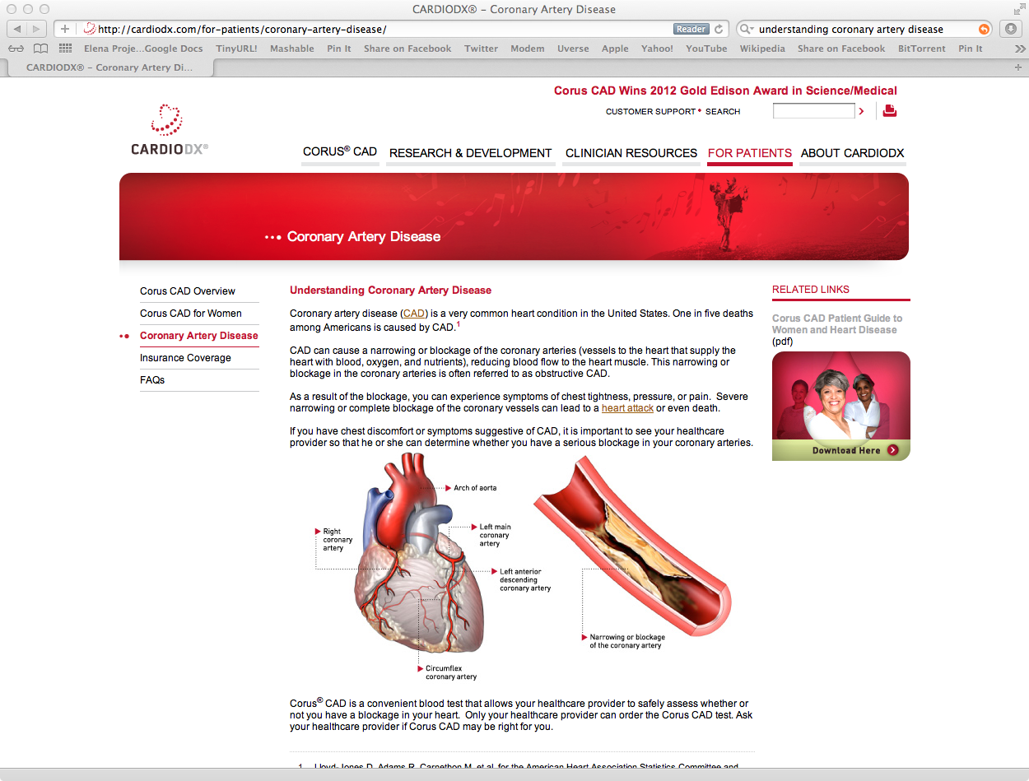
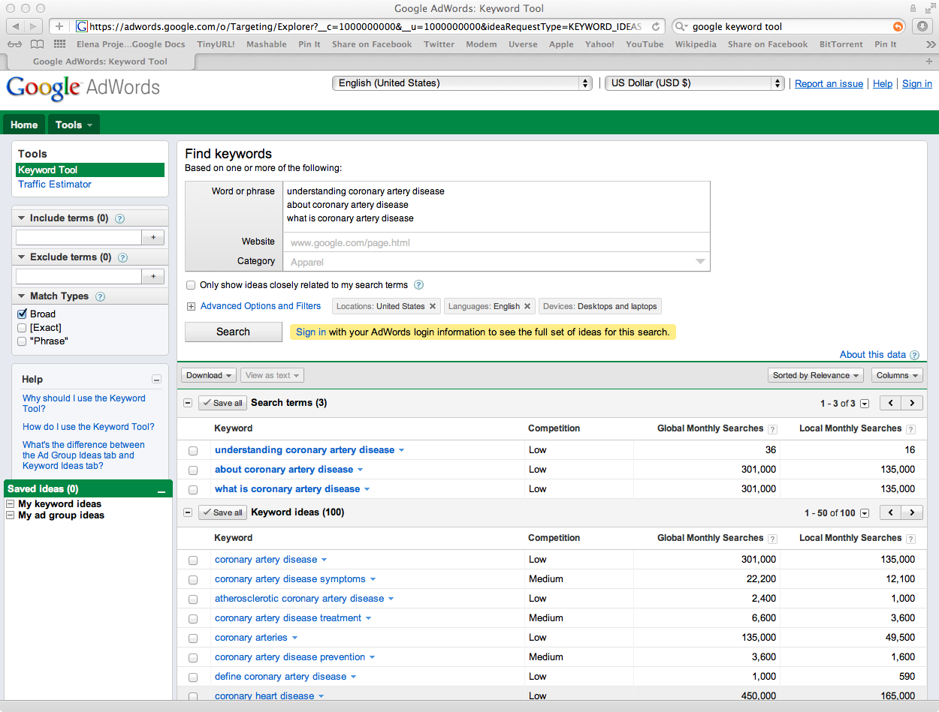
Search Engine Optimization #4: Integrating Keywords into Content
CardioDx can better integrate highly searched keywords into content and header tags
Google crawls not only tagged elements, but also content
Understanding Coronary Artery Disease
Current header for the “Coronary Artery Disease” page but is searched infrequently
Consider Changing Header To: what is coronary artery disease OR
about coronary artery disease (two keyphrases that are searched 8000-fold more in Google search)
x8000
Notes:
26
Integrate google crawl, index and relevancy into the slide more.

Slide 27
Search Engine Optimization Recommendation #5: Create a Board of Directors Page
Add a page for the Board of Directors under “About CardioDx”
Keyphrase “cardiodx board of directors” is one of the top 25 sources of search traffic
Visitors also enter the site by searching specific members of the board of directors, e.g. Louis Lange, but members of the Board of Directors are not listed on the site
When visitors search “cardiodx board of directors” they often enter through the “Team” page on the website - which is irrelevant
Companies that list their Board of Directors: Crescendo, Genomic Health, Exact Sciences, XDx, Myriad, Agendia
Result should be an increase in time on cardiodx.com, and specifically the board of directors’ page

Slide 28
Search Engine Optimization #6: Creating Relevant Content for the Women and Heart Disease Page
“Women and Heart Disease” page is not performing well
Current performance of the page:
73% bounce rate (11 entrances in 3 months. Small sample size because few visitors find the page through search engine results)
Google search keywords that lead to entrances are not relevant to “women and heart disease”, indicating that Google knows that the content of the page is not really about women and heart disease: Corus blood test, corus cad blood test, corus cad lab test, cardiodx, what is corus cad blood test.
Bounce Rate is the percentage of single-page visits (i.e. visits in which the person left your site from the entrance page).
Notes:
28

Slide 29
Recommendation #6: Create a Page About Women and Heart Disease
The keyphrase “women and heart disease” is searched 74,000 times a month.
A high quality, informative and relevant page exclusively about women and heart disease will increase traffic to CardioDx.com
CardioDx should either modify the current page or create a new/additional page that links to the homepage

Slide 30
Recommendation #6: “Women And Heart Disease” Modification
The “Women and Heart Disease link on the homepage connects to a page that is about Corus CAD, not specifically about women and heart disease
A site/page’s perceived value to users is increasing in importance so content should be adjusted so that’s its relevant to and consistent with link text, headers and titles
The recommendation is to change the content or add a page that is really about “women and heart disease”
Notes:
Show screen shot
Must increase relevance. Page title should match what’s on the homepage “Women and Heart Disease”. What does this article have to do with women and heart disease? Or is it about Corus CAD. Google isn’t sure, you’re not sure. This is why bounce rate is so high.

Slide 31

Landing Page Optimization #1: Homepage Flash Animation v. Static Image
Pros: Makes the site more interactive and dynamic.
Cons: Takes 31 seconds to load until it’s clickable. A very long time to wait for any sort of video or animation. Isn’t viewable on iOS Apple devices.
Flash Animation
Pros: Would take a fraction of a second to load and be immediately clickable. Appears the same on desktop and mobile devices.
Cons: Does not showcase what you do as effectively or tell a story.
Notes:
31
Pros and cons. Animate slide so that static image shows up second with pros and cons.

Slide 32
Recommendation #1A: Conduct Live Customer Research to Assess Preference for Flash v. Static Image
Two different versions of a webpage can be tested with live traffic
Measure the click through rate (CTR) for each version of the webpage
Now
A/B testing
After testing
flash
flash
Example: 15%
Example: 85%
Low CTR
Increase in CTR
Click through rate is the rate (expressed in a percentage) at which users click on a link to your page from a search engine results page.

Slide 33
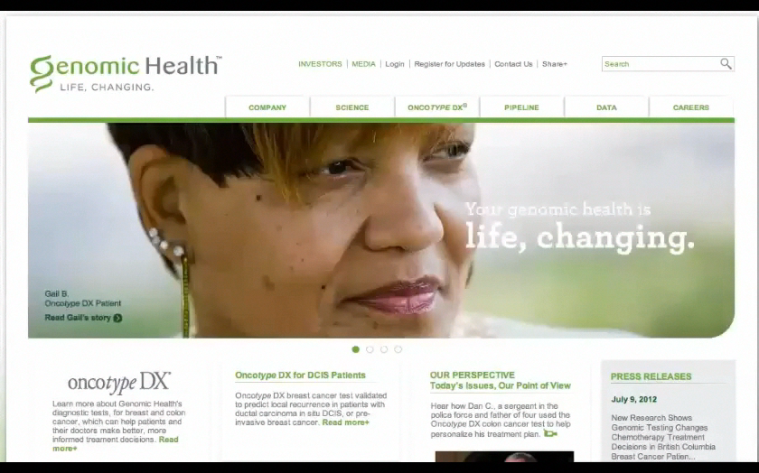
Recommendation #1B: Create Animated Slides like Genomic Health
Create slideshow style homepage and A/B test to measure consumer preference

Slide 34
Factors Important For Ranking Highly In Search Engine Results
Page Level Link Metrics This is the number of incoming links to a page. Search engines look at the quantity of unique incoming links as well as the topical relevance of the linking pages.
Domain Level Link Authority Features This is the number of incoming links to a domain as a whole.
Page Level Keyword Usage This refers to keywords in the HTML of your page. In order for your site to be indexed properly for search, you should be using keywords in the following: H1 Headings tags, HTML Page Titles, Meta Description, URLs, Images file names and ALT tags
Domain Level Keyword Usage As noted above, keywords should be used in your URLs.
Page Level Social Metrics Social media platforms are playing an increasingly important role in SEO. When asked about the future of search, the majority of respondents believe that social metrics will increase in importance.
* SEOmoz 2011 Search Ranking Factors
Notes:
34
Account for 21% of Google position

Slide 35
Off-Page SEO Recommendation: Social Media & Inbound Linking
Social Media Industry Benchmarking
Take a look at the social media strategies and efforts of other biotech/pharmas (great college internship project).
Look at channels, content of posts, regularity, engagement, interaction, and management.
Consider regular posts on Twitter and Facebook either about cardiology or more specifically about CardioDx and Corus CAD but carefully monitor to be FDA compliant (especially for any interactions).
Inbound Linking Strategy
A big way of increasing site rankings is to get referral traffic from other sites, especially influential or high quality ones.
Reaching out to influential sites through the CardioDx PR and marketing team as well as generating as much PR as possible. (It’s important to announce the article/mention on CardioDx.com and link back to their site as well. Outbound links aid in SEO rankings as well.)
Don’t pay for inbound links – Google will penalize you if they find you on link aggregator sites – and most reputable sites will not do it. Exceptions include exchanging a charity donation for a mention on their website (still ok for SEO) but must be handled delicately.
Notes:
Another thing to consider is that user behaviors, such as clicking on links which lead to other pages/site, also has a significant impact on your site’s SEO. In other words, if the search engines see that there is a lot of user activity on your site, that demonstrates that people are getting value out of your site and can have a positive impact on your SEO.
The building of outbound links is also valuable for building relationships with other website and blog owners, since the links will likely bring traffic to their sites.Edison Awards and LinkedIn are the biggest sources of referral traffic. The quality of the referral sites matter.
Social Media is increasing in ranking importance.
Most new Google search algorithm updates are weighting social metrics more heavily.

Slide 36
Summary
Site statistics
CardioDx.com has ~2,500 unique visitors/month and ~10,000 pageviews
Mobile Devices
Trends show that mobile viewing is on the rise. 10% of CardioDx.com visitors are on mobile devices
On-page optimization
Modifications of many on-page factors will increase search engine rankings and usability
Landing page optimization
Testing and changing out the Adobe Flash Animation for a static image has the potential to increase the click through rate
Off-page optimization
Inbound links and social metrics are becoming increasingly influential and are among the most important parameters for search engine ranking
Notes:
36

Slide 37
Recommendations
Edit, write and modify on-page factors
Edit meta, title, header tags
Integrate high volume keywords and keyphrases into page content.
Create new Board of Directors page modeled on Team page
Increase relevance of Women and Heart Disease page by adding content
Test landing page components
Test Flash animation v. static image to optimize click through rate.
Determine next steps for off page optimization and mobile viewing
Strategize inbound linking plan, social media benchmarking project
Develop site easily viewable and navigable on mobile devices
Maintain site optimization going forward
Many or CardioDx.com’s URLs are over 115 characters – moving forward, keep them under
Every page should have a meta description tag – from now on, implement a plan to write one for each page

Slide 38

Back up slides

